Slide 1
Module 4- Trojans and other Attacks:
No. of Hours :8
Topics | Reference Books
Trojans and other Attacks: Worms, viruses, Trojans, Types of worms, viruses and worms, Preventing malware attacks, types of attacks: (DoS /DDoS), Waterhole attack, bruteforce, phishing and fake WAP, Eavesdropping, Man-in-the-middle, buffer overflow, DNS poisoning, ARP poisoning, Identity Theft, IoT Attacks, BOTs and BOTNETs, Steganography - text, image and audio and video, types of Social Engineering: Physical social engineering, Remote social engineering and hybrid social engineering. | Reference books slide B_2,B_3,W_2

Slide 2
Viruses, Worms and Trojans
Similarities:
All these are malicious programs that can cause damage to the computers.
Differences :

Slide 3
Sr. No. |  | Viruses | Worms | Trojans
1 | Definition | A program code that attaches itself to application program and when application program run it runs along with it. | The worm is code that replicate itself in order to consume resources to bring it down. Similar to virus in design and it is sub-class of virus. | A Trojan appears to be a useful software but once installed and run, they will do damage to the computer.
2 | How does it infect a computer system? | Attaches itself to a file or executable program. | A worm has the ability to replicate itself. Your computer can send one or millions of worms.

Slide 4
Sr. No. |  | Viruses | Worms | Trojans
3 | How does it spread? | Like human virus, A virus may exist in your computer and may attach to the .exe file but the computer is not infected unless and until the infected file is run. It has to rely on users transferring infected files/programs to other computer systems. Imp: virus cannot run without a human action | A worm spreads from one computer to another. Imp: It does not rely on human action to spread | They may be installed on the computers along with the installation of other useful softwares from legitimate websites.

Slide 5
Sr. No. |  | Viruses | Worms | Trojans
4 | Does it infect files? | Yes, it deletes or modifies files. Sometimes a virus also changes the location of files. | Usually not. Worms usually only monopolize the CPU and memory of a computer. Because of its replicating nature, the worm consumes too much memory and network bandwidth causing the web servers, network and individual computers to stop responding. | They can do annoying activities like adding and changing the desktop icons or more dangerous activities like deleting files on your system. Trojans known to create backdoors on your computer giving malicious users access to the system allowing personal and confidential information to be compromised.

Slide 6
Sr. No. |  | Viruses | Worms | Trojans
5 | whose speed is more? | virus is slower than worm. | worm is faster than virus. E.g.The code red worm affected 3 lack PCs in just 14 Hrs.
6 | Examples | Brain virus, Lehigh virus, Melissa virus | Morris worm, CodeRed worm, ILOVEYOU worm

Slide 7
Virus and Worms
Virus:
Computer virus is
A program that can "infect" legitimate programs by modifying them to include a possibly "evolved" copy of itself.
A computer virus passes from computer to computer in a similar manner as a biological virus passes from person to person. Viruses may also contain malicious instructions that may cause damage or annoyance;
Viruses can often spread without any readily visible symptoms.
A virus can start on:
Event-driven effects (e.g., triggered after a specific number of executions),
Time-driven effects (e.g., triggered on a specific date, such as Friday the 13th) or
Can occur at random.

Slide 8
Virus and Worms
Viruses can take some typical actions:
Display a message to prompt an action which may set of the virus;
Delete files inside the system into which viruses enter;
Sscramble data on a hard disk;
Cause erratic screen behavior;
Halt the system (PC);
Just replicate themselves to propagate further harm.
The following figures explain how viruses spread
(a) through the Internet,
(b) through a stand-alone computer system and
(c) through local networks.

Slide 9
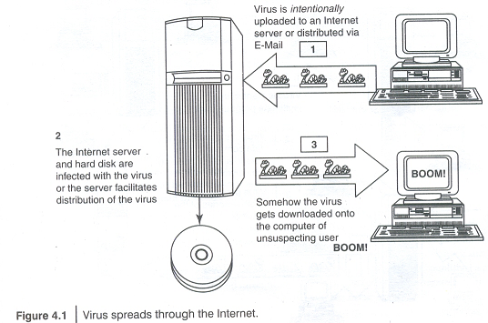

Slide 10
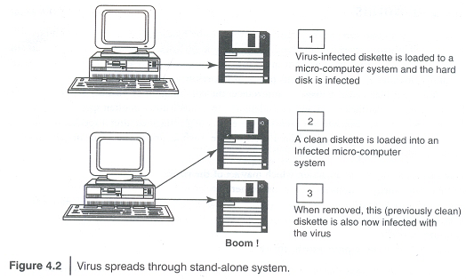

Slide 11
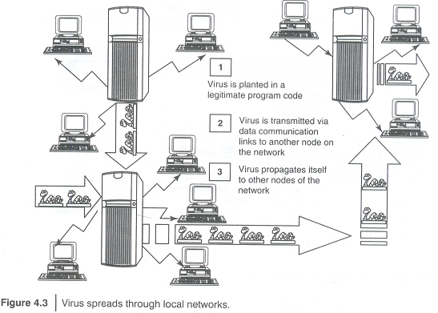

Slide 12
Types of viruses
Boot sector viruses:
Infects the storage media on which OS is stored (e.g., floppy diskettes and hard drives) and which is used to start the computer system.
The entire data/programs are stored on the floppy disks and hard drives in smaller sections called sectors. The first sector is called the BOOT and it carries the master boot record (MBR). MBR's function is to read and load OS, that is, it enables computer system to start through OS.
Hence, if a virus attacks an MBR or infects the boot record of a disk, such floppy disk infects victim's hard drive when he/she reboots the system while the infected disk is in the drive.
Once the victim's hard drive is infected all the floppy diskettes that are being used in the system will be infected.
Boot sector viruses often spread to other systems when shared infected disks and pirated software(s} are used.

Slide 13
Program viruses:
These viruses become active when the program file (usually with extensions .bin, .com, .exe, .ovl, .drv) is executed (i.e., opened - program is started).
Once these program files get infected, the virus makes copies of itself and infects the other programs on the computer system.
Multipartite viruses:
It is a hybrid of a boot sector and program viruses.
It infects program files along with the boot record when the infected program is active.
When the victim starts the computer system next time, it will infect the local drive and other programs on the victim's computer system.

Slide 14
Stealth viruses:
It camouflages and/or masks itself and so detecting this type of virus is very difficult.
It can disguise itself such a way that antivirus software also cannot detect it thereby preventing spreading into the computer system.
It alters its file size and conceals itself in the computer memory to remain in the system undetected. The first computer virus, named as Brain, was a stealth virus.
A good antivirus detects a stealth virus lurking on the victim's system.
Polymorphic viruses:
It acts like a "chameleon" that changes its virus signature (i.e., binary pattern) every time it spreads through the system (i.e., multiplies and infects a new file). Hence, it is always difficult to detect polymorphic virus with the help of an antivirus program.
Polymorphic generators are the routines (i.e., small programs) that can be linked with the existing viruses. These generators are not viruses but the purpose of these generators is to hide actual viruses under the cloak of polymorphism. The first all-purpose polymorphic generator was the mutation engine (MtE) published in 1991. Other known polymorphic generators are
Dark Angel's Multiple Encryptor (DAME),
Darwinian Genetic Mutation Engine (DGME),
Dark Slayer Mutation Engine (DSME),
MutaGen, Guns'n'Roses Polymorphic Engine (GPE) and
Dark Slayer Confusion Engine (DSCE).

Slide 15
Macroviruses:
Many applications, such as Microsoft Word and Microsoft Excel, support MACROs (i.e., macrolanguages). These macros are programmed as a macroembedded in a document.
Once a macrovirus gets onto a victim's computer then every document he/she produces will become infected.
This type of virus is relatively new and may get slipped by the antivirus software if the user does not have the most recent version installed on his/her system.
Active X and Java Control:
All the web browsers have settings about Active X and Java Controls.
Little awareness is needed about managing and controlling these settings of a web browser to prohibit and allow certain functions to work - such as enabling or disabling pop-ups, downloading files and sound - which invites the threats for the computer system being targeted by unwanted software(s} floating in cyberspace.

Slide 16
World’s worst virus (Elaborate)
Conficker
INF/AuroRun
Win32 PSW.OnLineGames
Win32/Agent
Win32/FlyStudio
Win32/Pacex.Gen
Win32/Qhost
WMAJ/TrojanDownloader. GetCodec

Slide 17
World’s worst worm Elaborate)
Morris Worm
ILOVEYOU
Nimda
Code Red
Melissa
MSBlast
Sobig
Storm Worm
Michelangelo
Jerusalem

Slide 18
Trojan Horses
A program in which malicious or harmful code is contained inside apparently harmless programming or data in such a way that it can get control and cause harm,
for example, ruining the file allocation table on the hard disk.
A Trojan Horse may get widely redistributed as part of a computer virus. The term Trojan Horse comes from Greek mythology about the Trojan War.
How do Trojans work?
Like Spyware and Adware, Trojans can get into the system in a number of ways, including from a web browser, via E-Mail or in a bundle with other software downloaded from the Internet.
Transfering trojans through a USB flash drive or other portable media.
Unlike viruses or worms, Trojans do not replicate themselves but they can be equally destructive.
On the surface, Trojans appear benign and harmless, but once the infected code is executed, Trojans perform malicious functions to harm the computer system without the user's knowledge.
For example, waterfalls.scr is a waterfall screen;However, it can be associated with malware and become a Trojan to unload hidden programs and allow unauthorized access to the user's Pc.

Slide 19
Trojan Horses
Some typical examples of threats by Trojans are as follows:
They erase, overwrite or corrupt data on a computer.
They help to spread other malware such as viruses (by a dropper Trojan).
They deactivate or interfere with antivirus and firewall programs.
They allow remote access to your computer (by a remote access Trojan).
They upload and down load files without your knowledge.
They gather E-Mail addresses and use them for Spam.
They log keystrokes to steal information such as passwords and credit card numbers.
They copy fake links to false websites, display pomo sites, play sounds/videos and display images.
They slow down, restart or shutdown the system.
They reinstall themselves after being disabled.
They disable the task manager.
They disable the control panel.

Slide 20
Backdoor
A means of access to a computer program that bypasses security mechanisms.
A programmer may sometimes install a backdoor so that the program can be accessed for troubleshooting or other purposes.
However, attackers often use backdoors that they detect or install themselves as part of an exploit.
A backdoor works in background and hides from the user.
It is very similar to a virus and, therefore, is quite difficult to detect and completely disable.
Most backdoors are autonomic malicious programs that get installed to a computer.

Slide 21
What a backdoor does?
Following are some functions of backdoor:
It allows an attacker to create, delete, rename, copy or edit any file, execute various commands;
Change any system settings; alter the Windows registry; run, control and terminate applications;
Install arbitrary software and parasites.
It allows an attacker to control computer hardware devices, modify related settings, shutdown or restart a computer without asking for user permission
It steals sensitive personal information, valuable documents, passwords, login names, ID details; logs user activity and tracks web browsing habits.
It records keystrokes that a user types on a computer's keyboard and captures screenshots,

Slide 22
What a backdoor does?
Following are some functions of backdoor:
It sends all gathered data to a predefined E-Mail address, uploads it to a predetermined FTP server or transfers it through a background Internet connection to a remote host.
It infects files, corrupts installed applications and damages the entire system.
It distributes infected files to remote computers with certain security vulnerabilities and performs attacks against hacker-defined remote hosts.
It installs hidden FTP server that can be used by malicious persons for various illegal purposes.
It degrades Internet connection speed and overall system performance, decreases system security and causes software instability. Some parasites are badly programmed as they waste too many computer resources and conflict with installed applications.
It provides no uninstall feature, and hides processes, files and other objects to complicate its removal as much as possible.

Slide 23
Examples of Backdoor Trojans(Elaborate)
Back Orifice
Bifrost
SAP backdoors
Onapsis Bizploit

Slide 24
How to protect from trojans and backdoors
Stay away from suspect websites/weblinks:
Avoid downloading free/pirated sofrwares that often get infected by Trojans, worms, viruses.
Surf on the Web cautiously:
Avoid connecting with and/or down loading any information from peer-to-peer (P2P) networks, which are most dangerous networks to spread Trojan Horses and other threats.
P2P networks create files packed with malicious software, and then rename them to files with the criteria of common search that are used while surfing the information on the Web.
Install antivirus/Trojan remover software:
Nowadays antivirus softwares) have built-in feature for protecting the system not only from viruses and worms but also from malware such as Trojan Horses.
Free Trojan remover programs are also available on the Web and some of them are really good.

Slide 25
Steganography
Greek word, means “sheltered writing” or “protected writing”
Method to hide the existence of a message or a communication
Steganos : “covered” and graphein: “to write”
Used for centuries all across the world.
Originally started in Greece where
the messages were carved into wooden tables and then covered with wax
Messages where passed by shaving a messenger’s head ,tatooing a secret message and letting his hair grow back and then shaving it after he arrived at the receiving party to reveal the message.
Different names for steganography:
Data hiding, information hiding , digital watermarking
Aids in confidentiality and integrity of data

Slide 26
Difference between steganography and cryptography:
Steganography :
Art and science of writing hidden messages in such a way that no one apart from the recipient knows the existence of the message.
Hidden messages could be ignored.
Cryptography:
Existence of the message is known but it is obscured or encrypted.
Encrypted message could arouse suspicion
Usage:
Normally used by terrorists.
Eg: NYT published an article that al-Qaeda used steganographic techniques to hide messages into images, transported these via e-mails and execute the 9/11 attack.

Slide 27
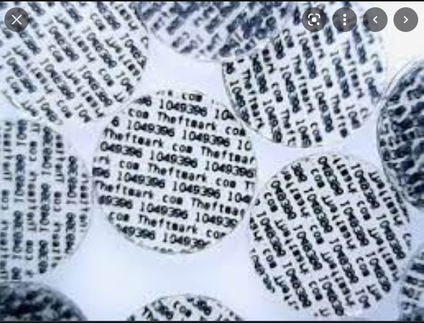
Hidden text on wax tablets:
The first use of steganography is reported by Herodotus, the so-called father of history.He said that in ancient Greek, hidden text was written on wax tablets. When Demeratus wanted to notify Sparta that the king of Persia, Xerxes, intended to invade Greece, he wrote this message on a tablet and covered it with wax. To recover the message the other people in Sparta simply had to scrape the wax off the tablet.
Use of chemical substances to conceal information.
Invisible ink, which was originally made of organic substances (milk or lemon-based ink). The secret message can be written between lines with the invisible ink. If the document is heated gently, the letters written with the special ink will become visible.
Mircrodot technology:
During World War II, the Germans developed the so-called microdot technology. Microdots are very small photographs (the size of a printed period) which can contain the whole content of a typewritten page
https://www.youtube.com/watch?v=SMJV7Xci_Qw
https://www.youtube.com/watch?v=c8LrqAm3CfA&t=6s

Slide 28
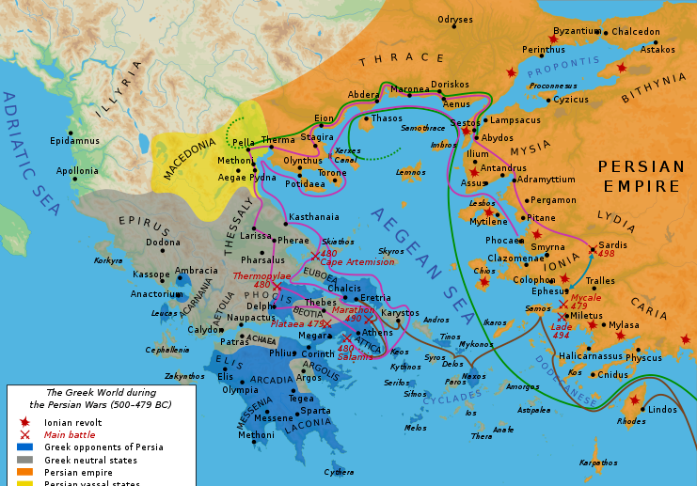

Slide 29
The “covering medium” could be
Innocent message,
Data
Audio,
Picture
video

Slide 30
Steganography tools | Description
DiSi-steganograph | Very small DOS-based steganographic program that embeds data in PCX images.
Invisible folders | Ability to make any file or folder invisible
Invisible secrets | Encrypts the data and files for safe-keeping Secure transfer over the net Hides the data in places such as picture, sound files or webpages.
Stealth files | Hides any types of files in almost any other types of files.
DriveCrypt Plus | Allows secure hiding of an entire OS inside the free space of another OS Full-disk encryption Before machine boots, a password is asked to decrypt the disk and start your machine

Slide 31
Steganography tools | Description
MP3Stego | Hides information in MP3 files during the compression process.
MSU Stego Video | Hides any file in a video Main features: small video distortions after hiding information information is protected with the password
https://www.youtube.com/watch?v=_8wAUdKF9Yk

Slide 32
Steganalysis
Art and science of detecting messages that are hidden in images, audio/video files using steganography.
Goal:
To identify suspected packages and if possible recover it.
Steganalysis Tools:

Slide 33
Steganalysis tools | Description
StegAlyzerAS | Digital forensic analysis tool to scan “suspect media”
StegSpy | Detects the location of the hidden content
Stegdetect | Automated tool for detecting steganographic content in the images.
Stegsecret | Open-source project that makes detection of hidden information possible in different digital media
Virtual Steganographic Laboratory(VSL) | Allows complex use both for steganography and steganalysis

Slide 34
Reference books:
B_1. Ethical Hacking by Tutorialspoint -e-book by TutorialsPoint
B_2. All-In-One-CEH-Certified-Ethical-Hacker-Exam-Guide by Matt Walker
B_3. Basics of ethical hacking for beginners by Manthan Desai
B_4. Cyber Security: Understanding Cyber Crimes, Computer Forensics and Legal
Perspectives by Sunit Belapure Nina Godbole
B_5.Srinivasan, J. Suresh, Cloud Computing: A practical approach for learning and
implementation, Pearson, ISBN :9788131776513
B_6 Certified Ethical Hacker Study Guide v9, Sean-Philip Oriyano, Sybex; Study Guide
Edition,2016
B_7 Comptia Security+ Study Guide Emmett Duley and Chuck Easttom
B_8 Ethical hacking by Alana Maurushat
Web References:
W_1. Code of ethics link https://cert.eccouncil.org/code-of-ethics.html
W_2. https://arc.bukancoder.co/Certified-Ethical-Hacker-Module-V8/
W_3. https://www.edureka.co/blog/steganography-tutorial
W_4. https://www.guru99.com/how-to-hack-using-social-enginering.html
Module 1

Slide 35
DoS Attacks
In this type of attack,the attacker
floods victim’s network with data.
Fills his email box with spam mail
thereby depriving him of the services he is entitled to access or provide.
DoS in general means
Preventing the internet site or service from functioning efficiently
Targets:
Web servers like
Banks
Credit card payment gateways
Mobile phone networks
Domain Name Servers (When alphanumeric address such as WWW.EXAMPLE.COM is used, the user’s computer needs to understand what numerical IP addresses it needs to contact, and this is accomplished through DNS servers.

Slide 36
How IP spoofing is carried out?Example
Symptoms of DoS attacks:
Slow network performance
Unavailability of website
Inability to access any website
Increase in the number of spam e-mails received.
A DoS attack does the following:
Flood the network with traffic preventing legitimate network traffic.
Disrupt connections between two systems preventing access to a service.
Prevent an individual from accessing a service
Disrupt service to a specific system or person.

Slide 37
Types or levels of DoS attacks
Flood attacks:
Also known as ping flood.
Attacker sends the victim large number of ping packets by using ping command which result into more traffic.
Requirements for such attacks
Attacker requires faster network connection than the victim.
Simple to launch but difficult to prevent it.
SYN attacks:
Also known as TCP SYN flooding.
In TCP, handshaking of network connections is done with SYN and ACK messages.
Diagram

Slide 38
Types or levels of DoS attacks
Ping of Death Attack:
Sends oversized Internet Control Message Protocol(ICMP packets)
Used by networked computer’s OS to send error messages to the victim such as
A requested service is not available or
A host or router could not be reached
Maximum packet size allowed is 65,536 octets.
Some systems on receiving this oversized packets will crash, freeze or reboot resulting in DoS attack.

Slide 39
Types or levels of DoS attacks
Teardrop attacks:
Fragmented packets are forged to overlap each other when the receiving host tries to reassemble them.
IP’s packet fragmentation algorithm is used to send corrupted packets to confuse the victim and may hang the system.
OS can be crashed
Smurf(an experienced player who uses a new account to deceive other players into thinking he's a newbie) attacks:
Generating significant computer network traffic on a victim network.
Floods a target system via spoofed broadcast ping messages.
The host sends an ICMP echo request (ping) to a network broadcast address.
Diagram

Slide 40
Teardrop attack
A teardrop attack is a denial-of-service (DoS) attack
involves sending fragmented packets to a target machine.
Since the machine receiving such packets cannot reassemble them due to a bug in TCP/IP fragmentation reassembly, the packets overlap one another, crashing the target network device.
This generally happens on older operating systems such as Windows 3.1x, Windows 95, Windows NT and versions of the Linux kernel prior to 2.1.63.
One of the fields in an IP header is the “fragment offset” field, indicating the starting position, or offset, of the data contained in a fragmented packet relative to the data in the original packet. If the sum of the offset and size of one fragmented packet differs from that of the next fragmented packet, the packets overlap. When this happens, a server vulnerable to teardrop attacks is unable to reassemble the packets - resulting in a denial-of-service condition.

Slide 41
Classification of DoS attacks
DoS attacks | Description
Bandwidth attacks | Bandwith:- Measures how fast a device can send the data in a single cable. Example: if the attacker opens 100 pages of a site and keeps on refreshing and consuming all the bandwidth this creating a denial of service.
Logic attacks | Attack the weak points in the network software. Eg: web server or TCP/IP stack
Protocol attacks | Protocols-rules to be followed to send the data over the network. The protocol is attacked to consume excess amounts of its resources
Unintentional DoS attacks | Attack is not intentional or deliberate but due to a sudden popularity of the website.

Slide 42
Tools used to launch DoS attacks
DoS tools | Description
Jolt2 | The attack causes the target machine to consume 100% of the CPU time on processing of illegal packets.
Nemesy | Generates random packets of spoofed source IP to enable the attacker to launch DoS attack
Targa | Used to run 8 different DoS attacks. The attacker has the option to launch either individual attacks or try all the attaks until one is successful
SomeTrouble | Remoter flooder. Developed in Delphi

Slide 43
Note:
The DoS attack is usually the last resort of an attacker as the attacker does not gain any information.
It only annoys the target and interrupts the service.

Slide 44
Incidents
Incident 1:
The first major attack involving DNS servers occurred in January 2001.
Target was Register.com.
This attack lasted about a week before it could be traced back to all attacking hosts and shut off.
Used a list of tens of thousands of DNS records at the time of the attack.
Incident 2:
On June 25, 2009, the day Michael Jackson died, the searches related to Michael Jackson was so huge that Google News initially mistook it for an automated attack.
As a result, for about 25 minutes, when some people searched Google News they saw a "We're sorry" page before finding the articles they were looking for.

Slide 45
DDoS Attacks
The attacker may use your computer to attack another computer.
For instance, he can send huge amounts of data to a website or send spam to particular e-mail address.
The attack is “distributed” because the attacker is using multiple computers to launch DoS attack.
The systems that are being attacked are called “zombie systems’ or “secondary victims”
The main target is called “primary victim”.
Botnet is a popular medium to launch DoS/DDoS attacks
Tools used to launch DDoS attack:

Slide 46
The major advantages to an attacker of using a DDoS attacks:
Multiple attack machines can generate more attack traffic than one machine,
Multiple attack machines are harder to turn off than one attack machine, and
harder to track and shut down
Example:

Slide 47
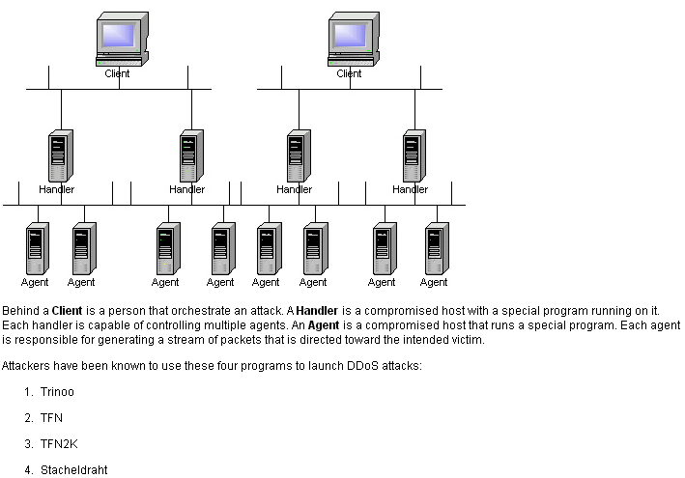

Slide 48
DDoS tools | Description
Trinoo | Set of computer programs used to conduct a DDoS attack.
Tribe Flood Network(TFN) | Set of computer programs to conduct DDoS attacks such as ICMP flood, SYN flood, UDP flood and Smurf flood.
Stacheldraht | Combines features of Trinoo with TFN and adds encryption
Shaft | A packet flooding attack and the client controls the size of the flooding packets and the duration of the attack

Slide 49
How to protect from DoS/DDoS attacks
Implement router filters. Install patches to guard against TCP SYN flooding.
Disable any unused network service.
Enable quota system on your OS.
Optional feature of the operating system
Used to limit the amount of disk space or the number of files to a user or to members of a group .
This prevents one user or group of users from consuming all of the available disk space.
Observe system’s performance and establish a baseline. Use this baseline to gauge unusual level of disk activity, CPU usage or network traffic.
Invest in redundant and fault-tolerant network configurations.
Maintain regular backup schedules and policies, particularly for important configuration information
Maintain appropriate password policies especially to highly privileged accounts such as Unix root password or windows administrator.
https://www.youtube.com/watch?v=H5YZ-a3g4a0
https://www.youtube.com/watch?v=ilhGh9CEIwM

